Slide 1
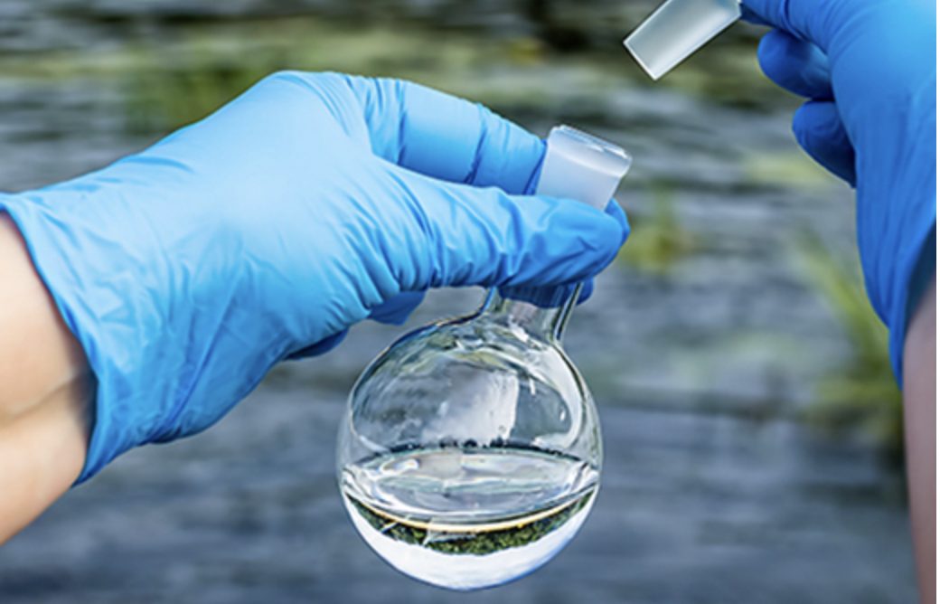
Environmental Sustainability
Water Quality Prediction
https://github.com/jessezimm/Environmental_Sustainability
Jessica Zimmerman
Beruchya Dao-Bai
Mohamad Kassim
Elizaveta Lyadova

Slide 2
Selected Topic and Reasoning
This project will seek to assess the potability of water resources samples conducted at over 3000 sites. This will contribute to an overall effort to encourage high standard drinking water for the health of people. This will also serve to ensure that water resources are safe for biodiversity such as plants and wildlife. All in all, this project will use a water quality lens to assess the health of water resources for public and environmental health purposes.

Slide 3
Questions to Answer through Model
We are going to implement a water quality prediction model using machine learning techniques. In this technique, our model will predict that the water is safe to drink or not.

Slide 4
About dataset
We are using a water potability database from https://www.waterqualitydata.us/.
Two datasets (water_table_1.csv and water_table_2.csv) were processed to form a single file, the water_potability.csv file by joining them on the index number. Our final dataset contains water quality metrics for 3276 different water bodies: pH value; Hardness; Solids; Chloramines; Sulfate; Conductivity; Organic_carbon; Trihalomethanes; Turbidity; Potability.
The database was created with Postgres using SQL to create a left join for the two initial tables. With an engine created in Jupyter notebook to access Postgres, our data can be accessed and modeled as needed.

Slide 5
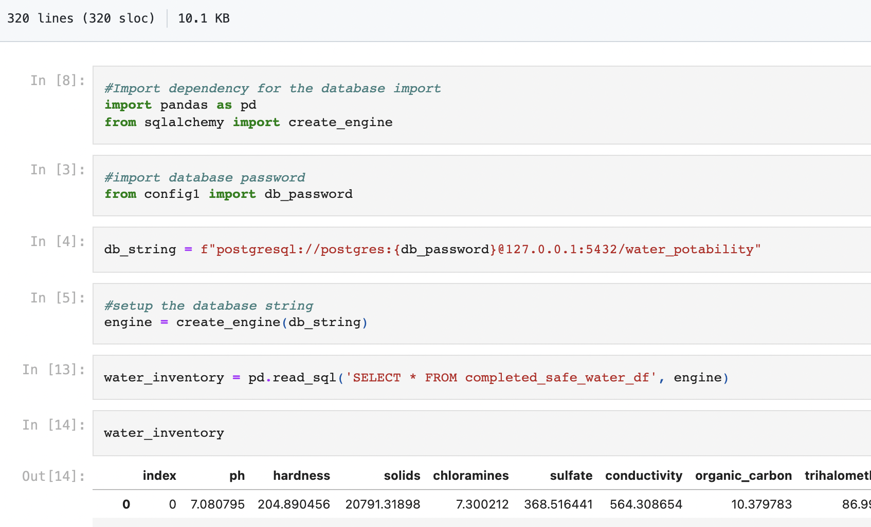
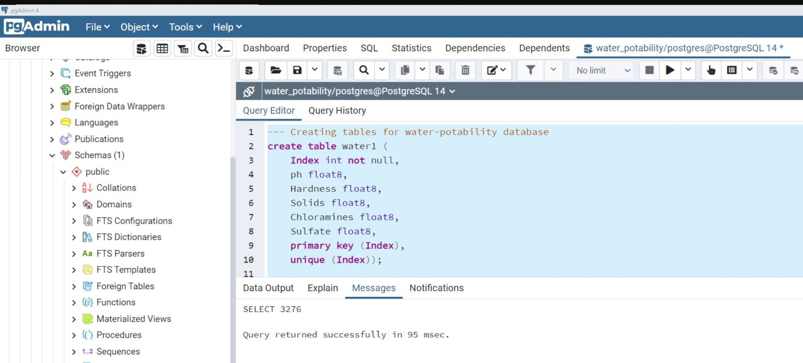

Slide 6
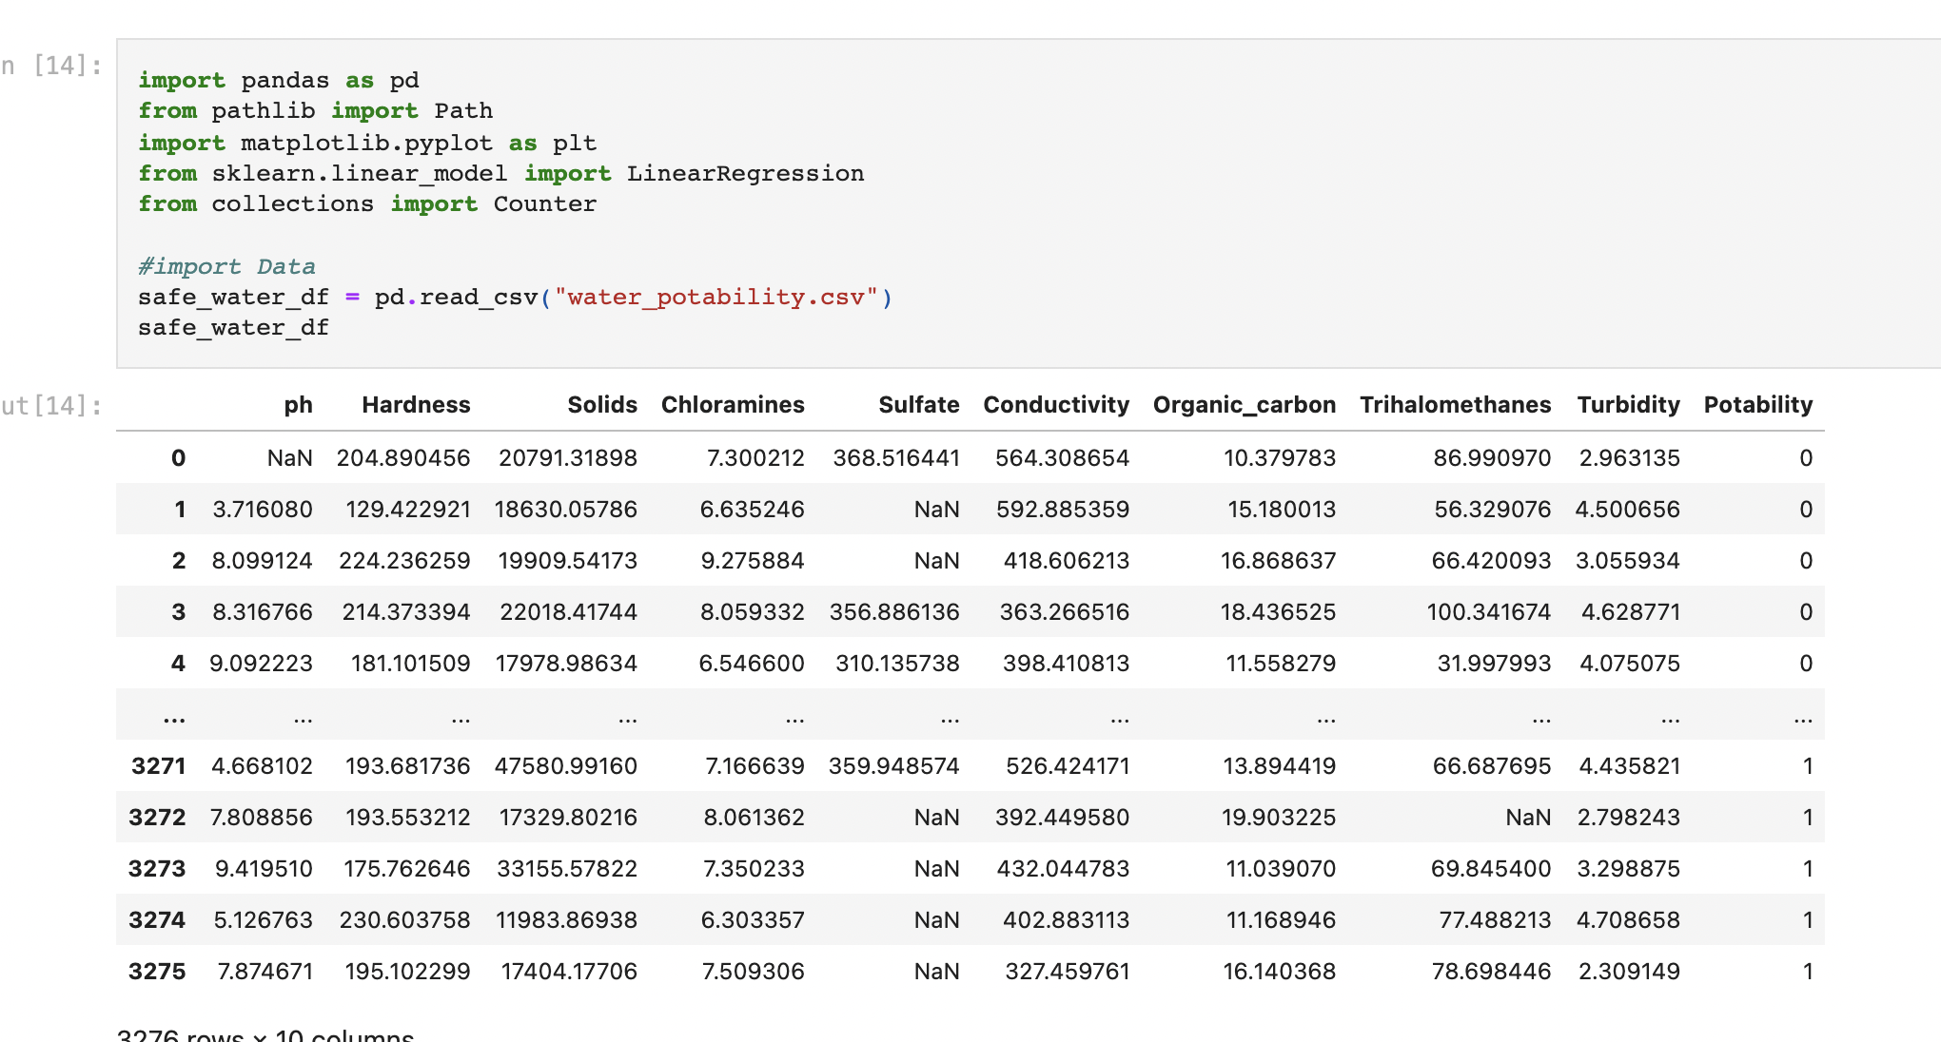
Data Gathering
Import all the required libraries which are used to train the model or visualise the data. Then load the data set using a Pandas’s function read_csv().

Slide 7
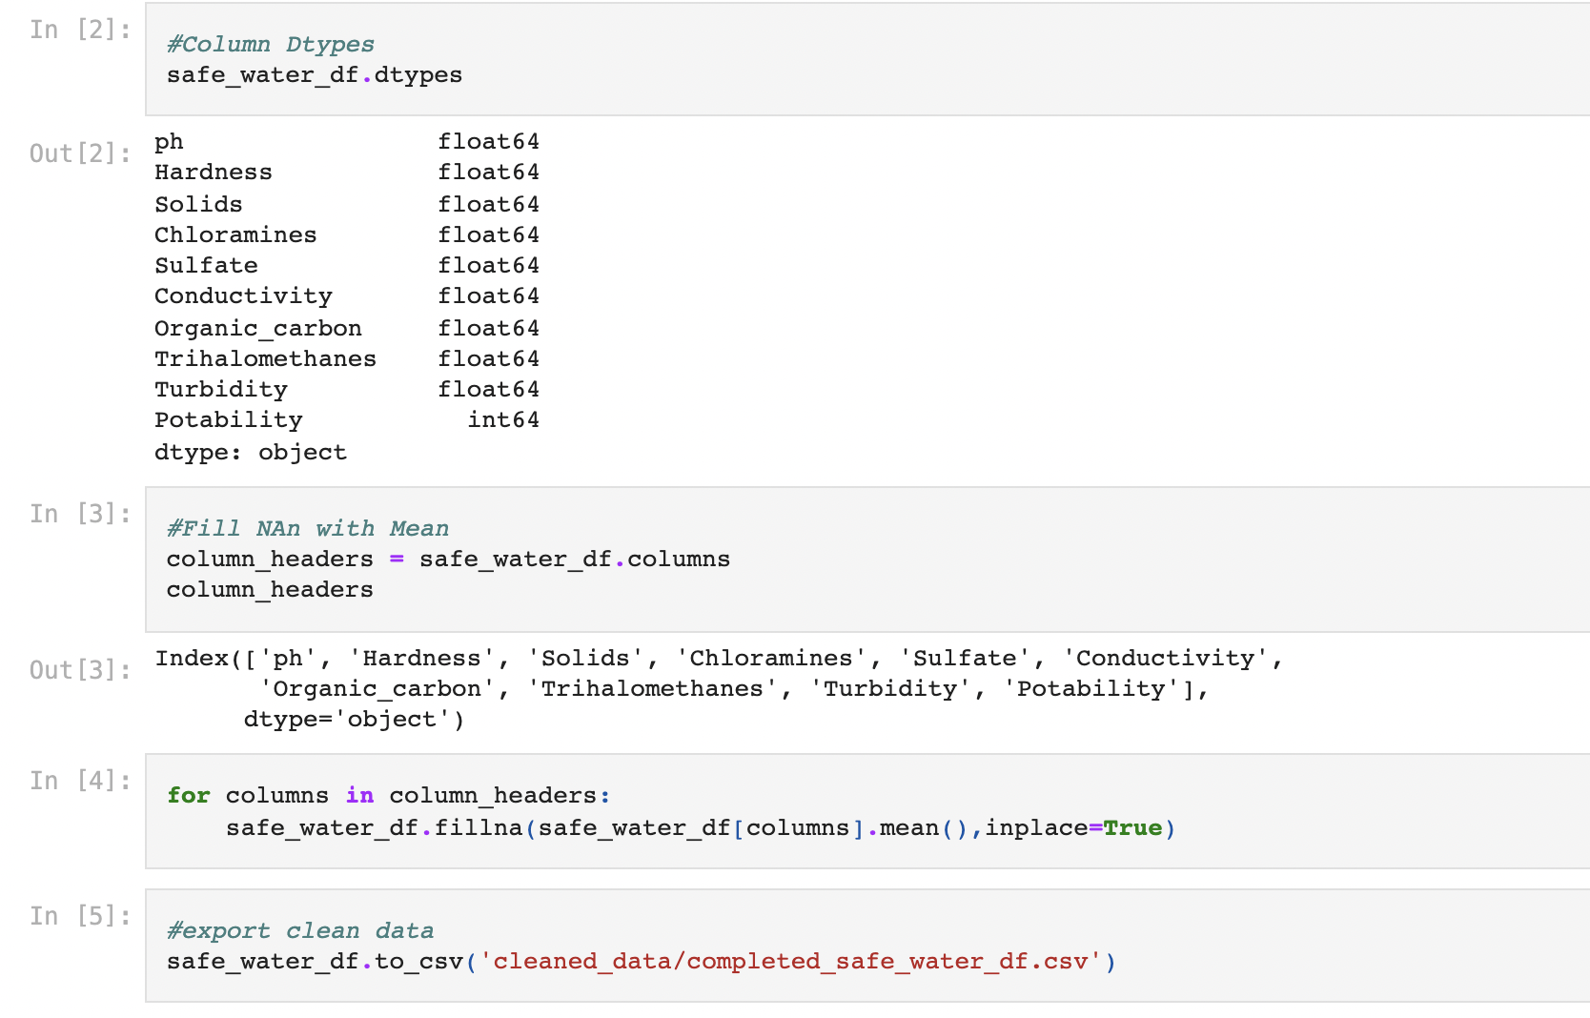
Exploratory Data Analysis
Check columns data types, then check that there are Null values or not.

Slide 8
Ensemble Learners
In this section, you will compare two ensemble algorithms to determine which algorithm results in the best performance. You will train a Balanced Random Forest Classifier and an Easy Ensemble AdaBoost classifier . For each algorithm, be sure to complete the following steps:
1. Train the model using the training data.
2. Calculate the balanced accuracy score from sklearn.metrics.
3. Print the confusion matrix from sklearn.metrics.
4. Generate a classification report using the `imbalanced_classification_report` from imbalanced-learn.
5. For the Balanced Random Forest Classifier, print the feature importance sorted in descending order (most important feature to least important) along with the feature score
Note: Use a random state of 1 for each algorithm to ensure consistency between tests

Slide 9
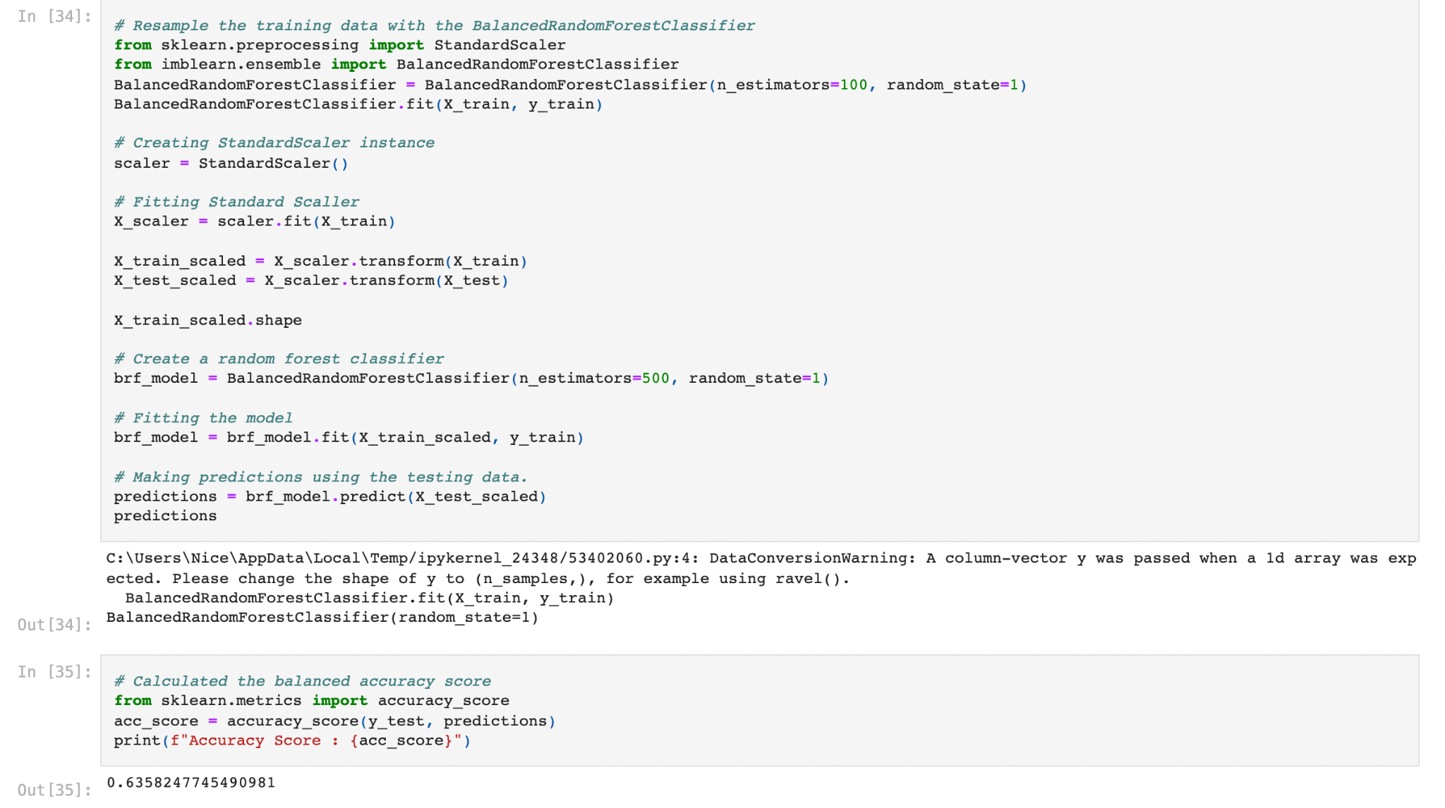
Balanced Random Forest Classifier

